Slide 1
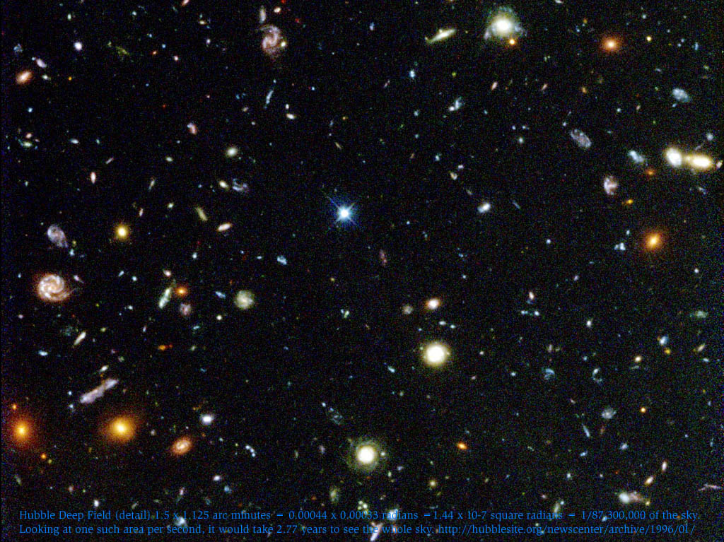
The Cosmos
Robert C. Newman

Slide 2
The Cosmos
Carl Sagan said: "The cosmos is all that is, or ever was, or ever will be."
If Christianity is true, Sagan is mistaken.
But we can perhaps define the cosmos as "All that we humans can see from in here where we have been placed."
Usually the terms 'cosmos' and 'universe' are used interchangeably.

Slide 3
The Cosmos
So the topics we want to look at for this lecture are:
What can we see from in here?
How have our observations & our theorizing interacted?
Let's take these topics in that order.

Slide 4
Looking Out… Further & Further

Slide 5
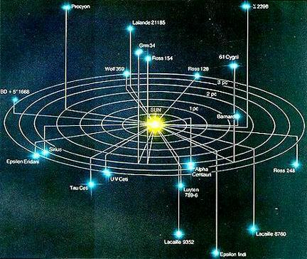
Nearest Stars

Slide 6
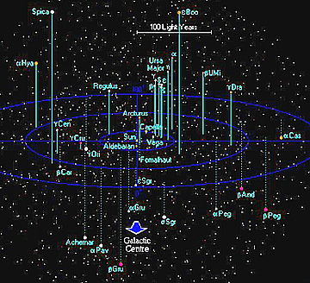
Stars to 250 ly

Slide 7
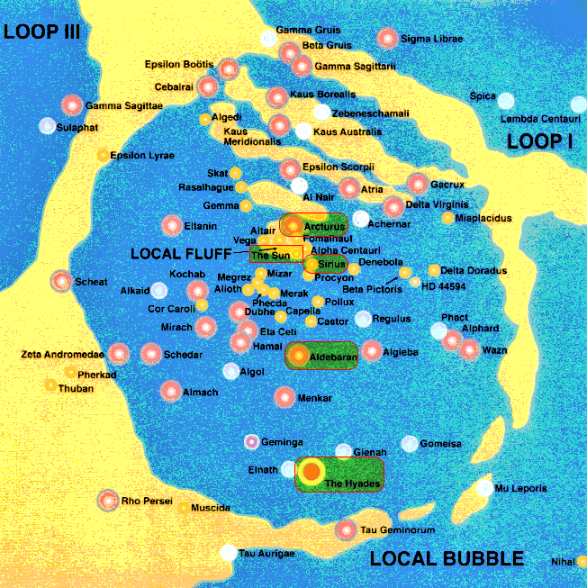
The Local Bubble

Slide 8
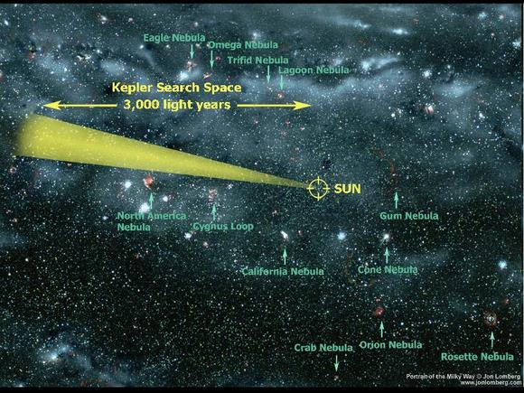

Slide 9
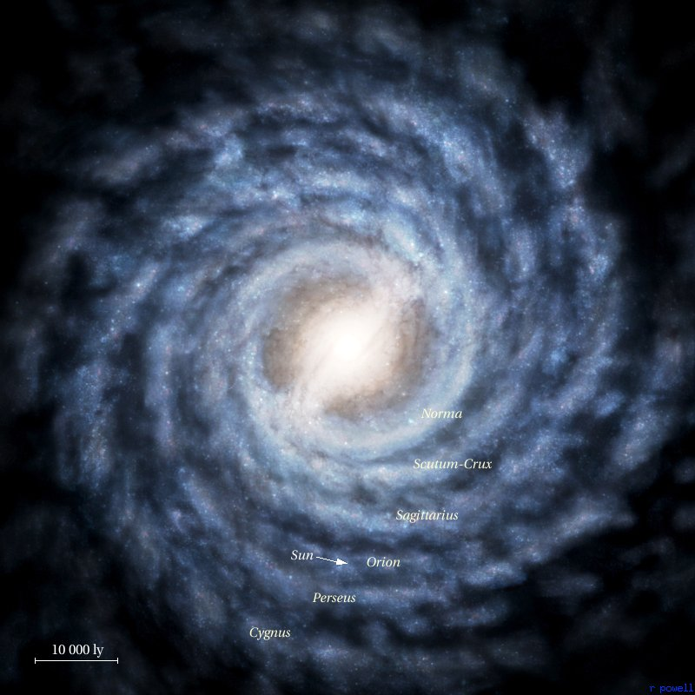
Our Galaxy

Slide 10
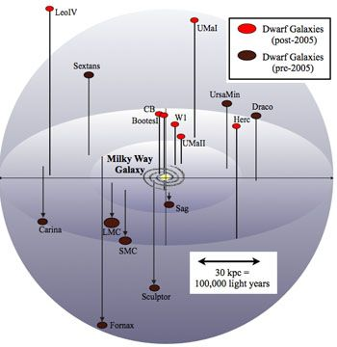

Slide 11
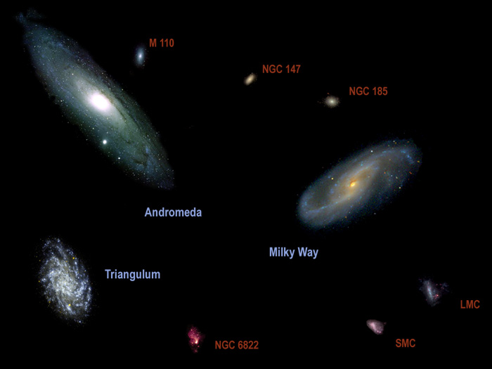
Local Group

Slide 12
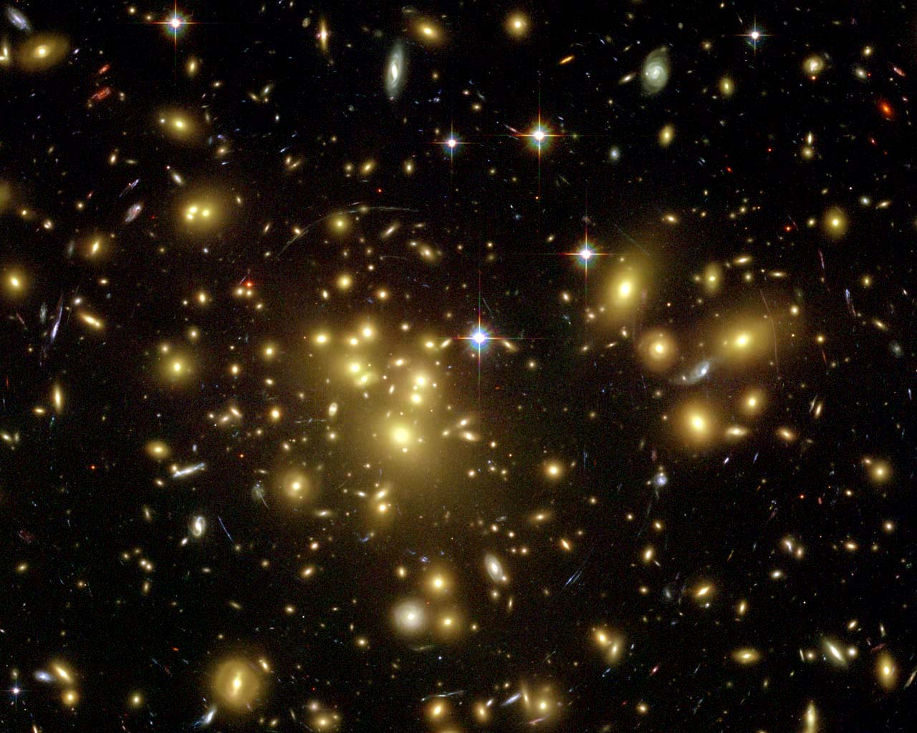
Galaxy Cluster Abell 1689

Slide 13
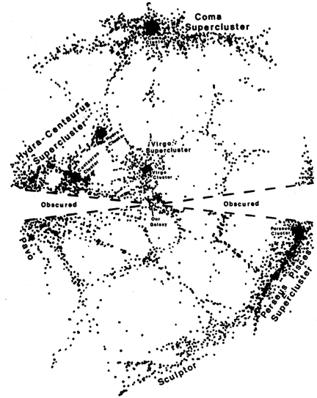

Slide 14
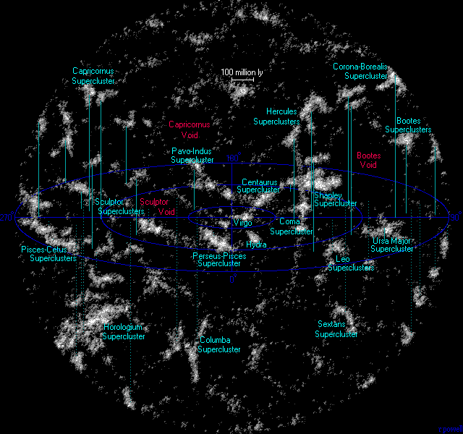
Superclusters

Slide 15
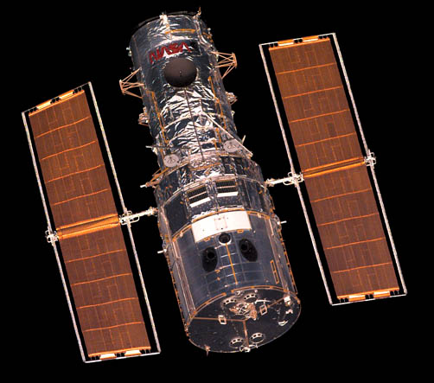
Hubble Space Telescope

Slide 16
Hubble Deep Field, 1996

Slide 17
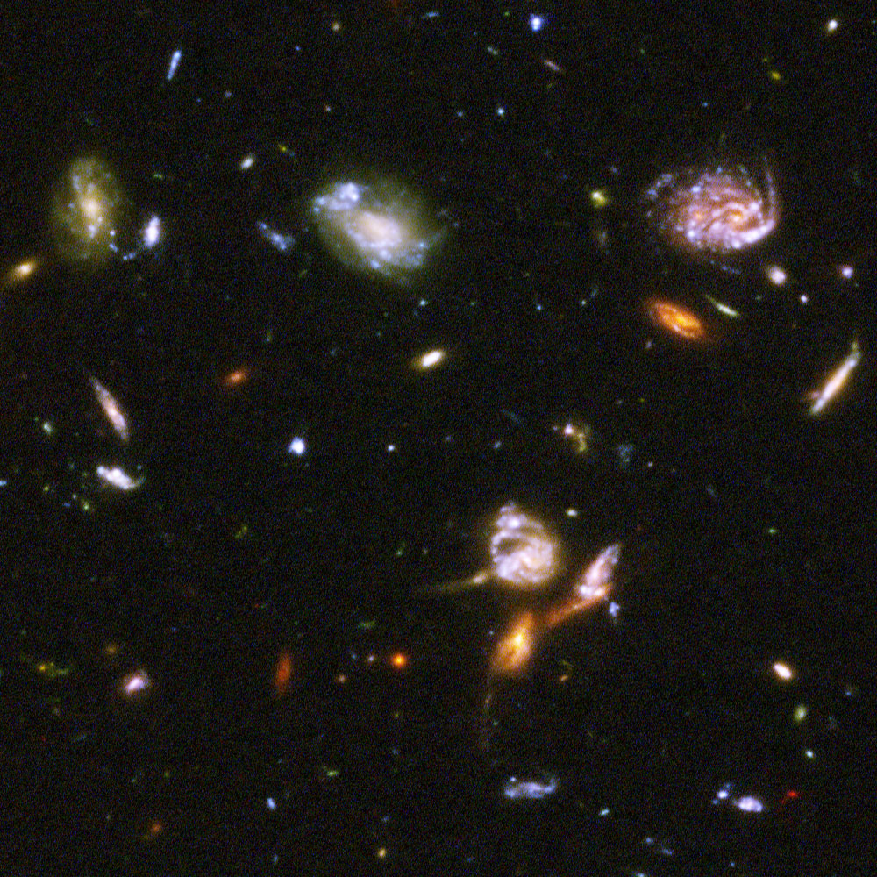
Ultra Deep Field, 2003/4

Slide 18
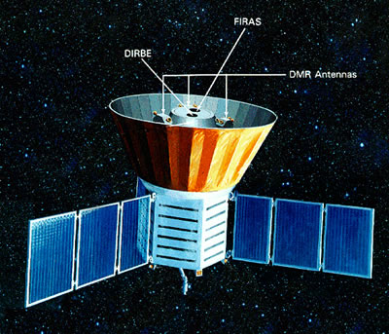
Cosmic Background Explorer

Slide 19
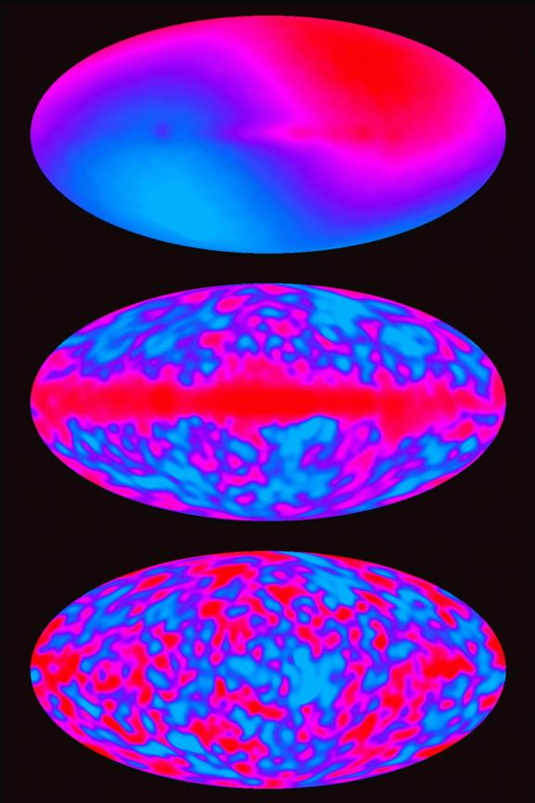
COBE Observations

Slide 20
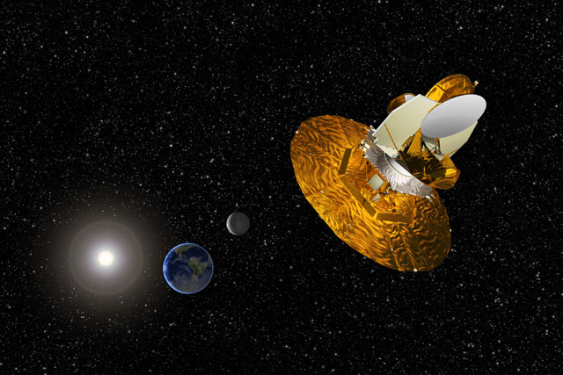
Wilkinson Microwave Anisotropy Probe

Slide 21
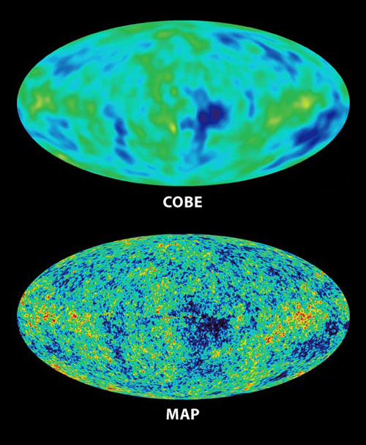

Slide 22
Observation & Theory

Slide 23
Observation & Theory
We have now given you a quick tour of observations.
Here we will consider how these have interacted with theory.
We give a sketch of cosmological theories.
Then we note the triumph of the big-bang.
Finally, we ask, "Where do we go from here?"

Slide 24
Cosmological Theories
At the beginning of the 20th century, many astronomers thought that the universe had always existed, and that it was basically static.
No one knew how stars burned, so they weren't sure how long they would last.
Einstein's general theory of relativity began to change all that.

Slide 25
General Relativity
When applied to the universe, Einstein saw that this predicted an expanding or contracting universe.
Since no one thought that was the case, Einstein added a 'fudge factor' to make it static.
But observations of galaxies in the 1910s and 20s by Slipher and Hubble showed the galaxies were moving apart.

Slide 26
The Big-Bang Theory
In the late 1920s, George Lemaitre proposed what later came to be called the big-bang theory.
He suggested that the universe was expanding from a very hot dense state, which he presumed to be creation.
Many were unhappy with this, as they didn't like the concept of a creation.

Slide 27
Alternatives to Creation
Some modified the big-bang theory to avoid a creation, by having one or more 'bounces' in the history of the universe.
Others proposed a steady-state theory, in which an infinite, eternal universe is continually expanding and adding more matter in such a way as to always look the same.

Slide 28
Observations & the Steady-State
Attempts to count the number of galaxies in a given volume at increasing distances suggested the universe was more crowded earlier in its history.
This became even more obvious when quasars were discovered in the 1960s and the same test was applied to them.
The steady-state theory had predicted that the density of the universe was constant everywhere in time and this didn’t seem to be the case.

Slide 29
The Cosmic Blackbody Radiation
Also in the mid-1960s, Penzias and Wilson discovered that the sky was 'glowing' in all directions at microwave frequencies.
This had been predicted years before as a consequence of big bang theories.
In the following years, this radiation was carefully measured at various wavelengths and found to fit the predicted blackbody spectrum.

Slide 30
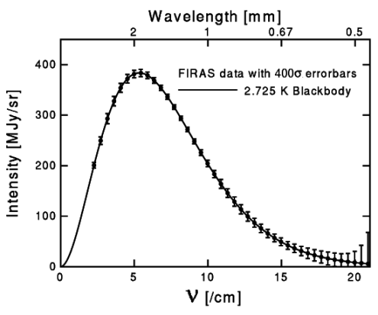

Slide 31
Triumph of the Big Bang
This essentially eliminated the steady-state theories from competition, leaving the field to varieties of the big bang.
Since then, the 'bouncing' varieties of the big bang have been eliminated as no way has been found to convert a collapsing universe into an expanding one.

Slide 32
Where Do We Go from Here?
The simplest reading for the big bang would be a creation event at the bang.
Scientists who don’t believe in a God prefer to think of our universe as just a bubble formed in an infinite, eternal, static universe.
So far, we have no clear evidence of more universes than our own.

Slide 33
Dark Matter
It has been known for many years that there is not enough visible matter in the galaxies to hold them together.
This led to the proposal of 'dark matter' (which we cannot see) as the source of the additional gravity.
This has apparently been confirmed by the recent data from WMAP.

Slide 34
Dark Energy
In the past few years, it has become apparent that (contrary to all expectations) our universe is expanding faster than it was earlier in its history.
A quantity called 'dark energy' is proposed to explain this acceleration of our universe's expansion.

Slide 35
The End

