Slide 1
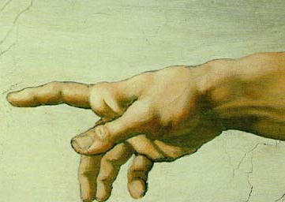
Discovering God's Fingerprints
Why the Christian Faith
Makes Sense
Robert C. Newman

Slide 2
Is Religion Wishful Thinking?
Why would Christians invent a God who:
Needs nothing, so you can't earn his favor?
Sees the most righteous as deserving punishment?
Holds those who know him better to a higher standard?
Will forgive the worst who repent?
Will condemn the most righteous who depend on themselves?

Slide 3
Atheists Wishful-Thinkers?
Easy to see why they wouldn’t want a God who:
Will judge all their actions & thoughts.
Restricts their behavior.
Condemns their sins.

Slide 4
Is Religion a Crutch?
Yes, religion is some sort of crutch!
Do we need a crutch?
Do we have the right sort of crutch?
Better to have a crutch than not be able to walk!

Slide 5
Is Humanity OK?
Crime?
Poverty?
Wars?
Abortion?
AIDS?
And more…

Slide 6
God's Fingerprints
God exists, and He has actually provided quite adequate evidence of His existence for those who really want to know. Consider:
The nature of the universe
Problems with atheistic versions of evolution
Design in inanimate nature
Fulfilled prophecy in the Bible
Jesus Christ
Changed lives and changed societies

Slide 7
Existence of Universe
Static eternal universe to Dynamic Universe
Steady-State to Big-Bang
Oscillating Universe to No-Bounce
Something from nothing?
Creator a more adequate explanation.

Slide 8
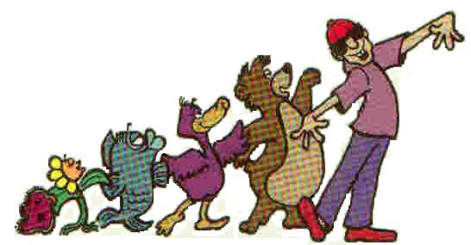
Evolutionary Alternative
What about evolution?
Doesn't that remove the need for God?
Didn't Darwin show there is no need for a Creator?
No.
Consider:

Slide 9
Problems with Atheistic Evolution
Origin of Life
Mutation & Natural Selection as source of order
Lack of transitions in fossil record
Creator a more natural explanation.
More clearly seen in evidence of design in non-animate part of nature.

Slide 10
Design in Inanimate Nature
Chemistry looks designed.
Environment looks designed.
Basic forces look designed.

Slide 11
Design in Chemistry
Carbon – unique in length of chains formed; in nearly equal-energy bonds.
Water – unique in high heat capacity, universal solvent, expansion on freezing.
Phosphorus – unique in ability to transfer energy.

Slide 12
Designed Earth
Temperature, water
Oxygen, gravity
Location in solar system
Location in galaxy
Type of sun
Type of moon
Over 60 other items

Slide 13
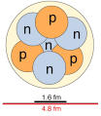
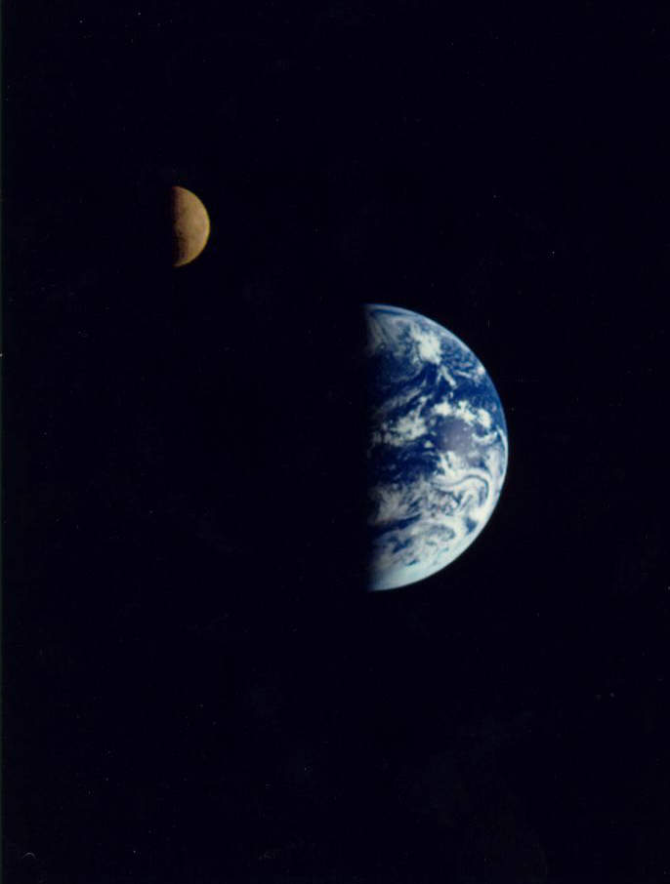
Fine-Tuned Basic Forces
Strong force and diversity of elements
Weak force and availability of elements
Electromagnetism and molecules
Gravity and long-lived stars
Balance of plus & minus charges
Balance of cosmic expansion & gravity

Slide 14
Alternative Explanations
A mere accident of observation – to have observers, have to have a universe that looks designed.
So there must be lots of universes!
Creator a more plausible explanation.

Slide 15
So, Theism?
OK, so there is a god or gods.
Why should we think it is the God of the Bible?
After all, there are hundreds of religions in our world.

Slide 16
Fulfilled Bible Prophecy
Tyre (Ezekiel 26) – rock scraped, dust thrown into sea
Babylon (Isaiah 13, Jeremiah 51) – no Arabs, no shepherds, stones not reused, parched desert
Israel (Hosea 3) – w/o king or prince, sacrifice or pillar, ephod or idol, for "many days"

Slide 17
Jesus Christ
Light to Gentiles (Isaiah 42 & 49) – only Jew claiming to be Messiah who has founded world religion
Messiah cut off at specified date (Daniel 9) – works out to AD 28-35
Historical reliability of Gospel accounts – if miracle not ruled out in advance, look very good

Slide 18
Changed Lives & Societies
What makes the first world different?
Science/technology – Christian roots
Personal freedom – Christian roots
See the books What if Jesus Had Never Been Born? and Under the Influence.

Slide 19
Conclusions
There is a God, and he is the One revealed in the Bible.
Human history does have significance.
So do our individual lives.
What we do with God will make all the difference between our lives being a disaster or a joy beyond our imagining.

Slide 20
The Place of Jesus?
The one being in the universe who is both created & uncreated.
He alone chose to become created, so his obedience to God was not owed.
If we trust Jesus, his obedience counts as ours.
If we trust him, his punishment counts as ours.
You, too, can trust him!

Slide 21
Not the End but the Beginning …
… if you trust in Jesus!

