Slide 1
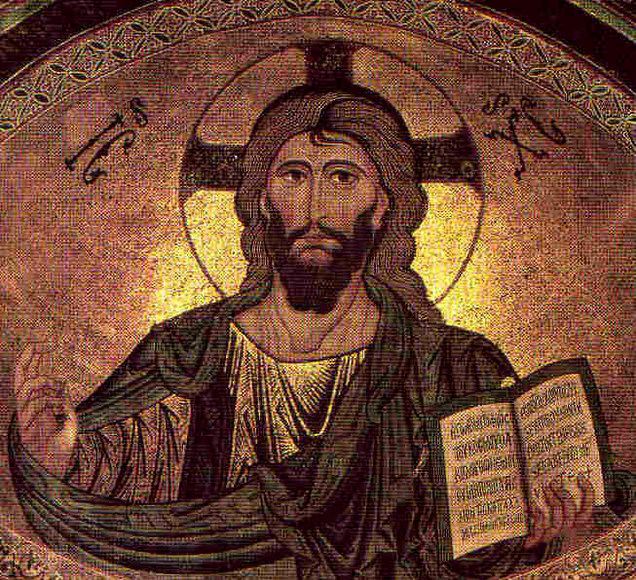

Jesus: Foundation of the NT
Introduction
Robert C. Newman

Slide 2
Foundation of the
"New Testament"
What is a "testament"?
  A covenant
What is a "covenant"?
The Covenant Theme
The New Covenant Theme

Slide 3
"Testament"
tes-ta-ment – n. [ME; Fr; L testamentum < testari, to testify, make a will < testis, a witness]. 1. In the Bible, a covenant; hence 2. Testament, either of the two parts of the Bible, the Old Testament and the New Testament: so called because considered covenants between God and man. 3. Testament [Colloq.], the New Testament. 4. In law, a will; now rare except in the phrase last will and testament.
Webster's New World Dictionary, College Edition, 1955

Slide 4
"Covenant"
cov-e-nant, n. [ME; OFr covenant, later couvenant, agreement, ppr. of covenir < L convenire]. 1. A binding and solemn agreement made by two or more individuals, parties, etc., to do or keep from doing a specified thing; compact. 2. An agreement among members of a church to hold to points of doctrine, faith, etc…. 6. In law, a) a formal, sealed contract… 7. In theology, the promises made by God to man, as recorded in the Bible. Webster's Collegiate, 1955.

Slide 5
The Covenant Theme
Noah
Abraham
Types of covenants
Sinai Covenant

Slide 6
The Covenant w/ Noah
Gen 6:18 But I will establish my covenant with you, and you will enter the arkCyou and your sons and your wife and your sons' wives with you.
Gen 9:9 I now establish my covenant with you and with your descendants after you 10 and with every living creature that was with youCthe birds, the livestock and all the wild animals, all those that came out of the ark with youCevery living creature on earth.

Slide 7
The Covenant w/ Noah
Gen 9:12 And God said, This is the sign of the covenant I am making between me and you and every living creature with you, a covenant for all generations to come: 13 I have set my rainbow in the clouds, and it will be the sign of the covenant between me and the earth.

Slide 8
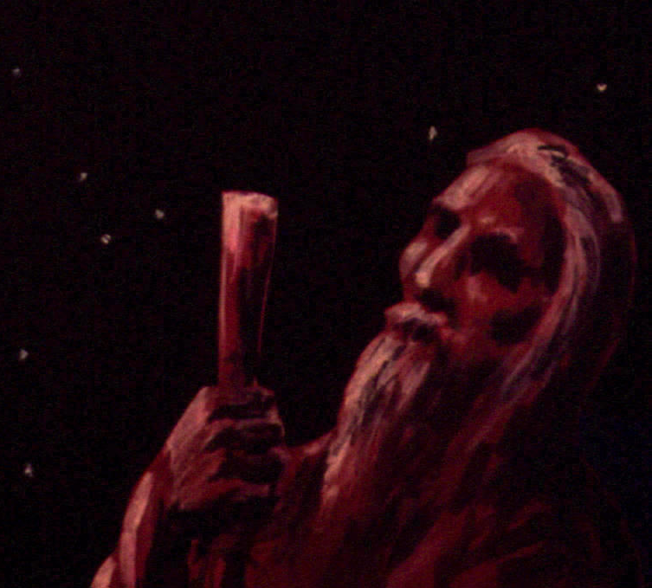
The Covenant w/ Abraham
Gen 15:18 On that day the LORD made a covenant with Abram and said, To your descendants I give this land, from the river of Egypt to the great river, the EuphratesC 19 the land of the Kenites, Kenizzites, Kadmonites, 20 Hittites, Perizzites, Rephaites …

Slide 9
The Covenant w/ Abraham
Gen 15:10 Abram brought all these [animals] to him, cut them in two and arranged the halves opposite each other … 17 When the sun had set and darkness had fallen, a smoking firepot with a blazing torch appeared and passed between the pieces.
Jer 34:18 The men who have violated my covenant … I will treat like the calf they cut in two and then walked between its pieces…

Slide 10
Types of Covenants
Parity covenant
  Between parties that are equal, that is, on a par with one another socially, legally
  The covenant is typically negotiated.
Suzerainty covenant
  Between parties that are unequal, one under the authority of the other
  The covenant is given by the suzerain.

Slide 11
The Sinai Covenant
Between God, who rescued them from slavery in Egypt…
And the rescued Israelites
God is the suzerain, Israel his vassals
He only is to be their God; they are to be his faithful people.

Slide 12
Sinai Covenant Inaugurated
Ex 24:3 When Moses went and told the people all the LORD's words and laws, they responded with one voice, Everything the LORD has said we will do … 6 Moses took half of the blood and put it in bowls, and the other half he sprinkled on the altar. 7 Then he took the Book of the covenant and read it to the people. They responded, We will do everything the LORD has said; we will obey. 8 Moses then took the blood, sprinkled it on the people and said, This is the blood of the covenant that the LORD has made with you in accordance with all these words.

Slide 13
Sinai Covenant
Blessings for obedience
  Lev 26:3-13 (11 verses)
  Deut 28:1-14 (14 verses)
Curses for disobedience
  Lev 26:14-39 (26 verses)
  Deut 28:15-68 (54 verses)

Slide 14
The New Covenant Theme
God's Servant – Isa 40-53
Covenant w/ Zion – Isa 54
Covenant w/ thirsty – Isa 55
The New Covenant – Jer 31
The Lord's Supper – Matt 26 etc.
Jesus as Guarantee – Heb 7-8

Slide 15
The Servant as Covenant
Isa 42:6 I, the LORD, have called you in righteousness; I will take hold of your hand. I will keep you and will make you to be a covenant for the people and a light for the Gentiles…
Isa 49:6 he says: It is too small a thing for you to be my servant to restore the tribes of Jacob and bring back those of Israel I have kept. I will also make you a light for the Gentiles, that you may bring my salvation to the ends of the earth.

Slide 16
The Servant as Covenant
Isa 49:7 This is what the LORD saysCthe Redeemer and Holy One of IsraelCto him who was despised and abhorred by the nation, to the servant of rulers: Kings will see you and rise up, princes will see and bow down, because of the LORD, who is faithful, the Holy One of Israel, who has chosen you. 8 This is what the LORD says: In the time of my favor I will answer you, and in the day of salvation I will help you; I will keep you and will make you to be a covenant for the people, to restore the land and to reassign its desolate inheritances…

Slide 17
The Covenant w/ Zion
Isa 54:9 To me this is like the days of Noah, when I swore that the waters of Noah would never again cover the earth. So now I have sworn not to be angry with you, never to rebuke you again. 10 Though the mountains be shaken and the hills be removed, yet my unfailing love for you will not be shaken nor my covenant of peace be removed, says the LORD, who has compassion on you.

Slide 18
The Covenant w/ Zion
Isa 54:11 O afflicted city, lashed by storms and not comforted, I will build you with stones of turquoise, your foundations with sapphires. 12 I will make your battlements of rubies, your gates of sparkling jewels, and all your walls of precious stones. 13 All your sons will be taught by the LORD, and great will be your children=s peace.

Slide 19
Covenant w/ Thirsty
Isa 55:1 Come, all you who are thirsty, come to the waters; and you who have no money, come, buy and eat! Come, buy wine and milk without money and without cost. 2 Why spend money on what is not bread, and your labor on what does not satisfy? Listen, listen to me, and eat what is good, and your soul will delight in the richest of fare. 3 Give ear and come to me; hear me, that your soul may live. I will make an everlasting covenant with you, my faithful love promised to David.

Slide 20
The New Covenant
Je 31:31 The time is coming, declares the LORD, when I will make a new covenant with the house of Israel and with the house of Judah. 32 It will not be like the covenant I made with their forefathers when I took them by the hand to lead them out of Egypt, because they broke my covenant, though I was a husband to them, declares the LORD.

Slide 21
The New Covenant
Jer 31:33 This is the covenant I will make with the house of Israel after that time, declares the LORD. I will put my law in their minds and write it on their hearts. I will be their God, and they will be my people. 34 No longer will a man teach his neighbor, or a man his brother, saying, Know the LORD, because they will all know me, from the least of them to the greatest, declares the LORD. For I will forgive their wickedness and will remember their sins no more.

Slide 22
Inaugurating the New Covenant
Mt 26:27 Then he took the cup, gave thanks and offered it to them, saying, Drink from it, all of you. 28 This is my blood of the covenant, which is poured out for many for the forgiveness of sins. 29 I tell you, I will not drink of this fruit of the vine from now on until that day when I drink it anew with you in my Father=s kingdom.
Lk 22:20 In the same way, after the supper he took the cup, saying, This cup is the new covenant in my blood, which is poured out for you.

Slide 23
Jesus as Guarantee of the New Covenant
Heb 7:20 And it was not without an oath! Others became priests without any oath, 21 but he became a priest with an oath when God said to him: The Lord has sworn and will not change his mind: You are a priest forever. 22 Because of this oath, Jesus has become the guarantee of a better covenant.

Slide 24
Jesus as Guarantee of the New Covenant
Heb 8:6-8: 6 But the ministry Jesus has received is as superior to theirs as the covenant of which he is mediator is superior to the old one, and it is founded on better promises. 7 For if there had been nothing wrong with that first covenant, no place would have been sought for another. 8 But God found fault with the people and said: The time is coming, declares the Lord, when I will make a new covenant with the house of Israel and with the house of Judah…

Slide 25
Jesus as Guarantee of the New Covenant
2 Cor 1:20 For no matter how many promises God has made, they are "Yes" in Christ. And so through him the "Amen" is spoken by us to the glory of God.

Slide 26
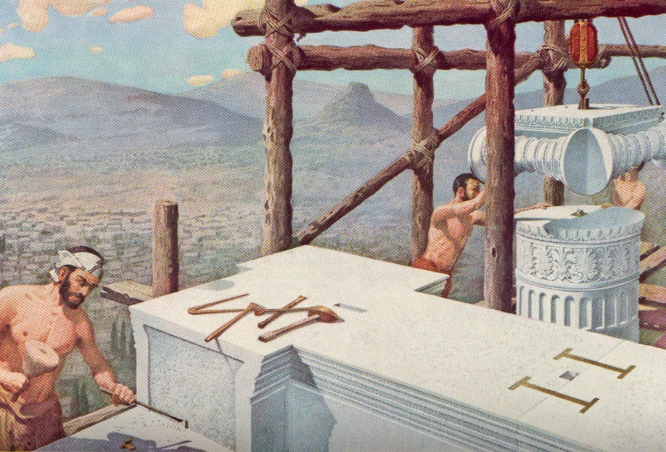
"Foundation" of the NT
Rock and Stone Theme
Foundation Theme

Slide 27

Rock and Stone Theme
God as Rock
God's Rock
Jesus as Fulfillment

Slide 28
God as Rock
Deut 32:4 He is the rock, his works are perfect, and all his ways are just. A faithful God who does no wrong, upright and just is he… 15 Jeshurun grew fat and kicked; filled with food, he became heavy and sleek. He abandoned the God who made him and rejected the rock his Savior… 18 You deserted the rock, who fathered you; you forgot the God who gave you birth.

Slide 29
God as Rock
Isa 8:13 The LORD Almighty is the one you are to regard as holy, he is the one you are to fear, he is the one you are to dread, 14 and he will be a sanctuary; but for both houses of Israel he will be a stone that causes men to stumble and a rock that makes them fall. And for the people of Jerusalem he will be a trap and a snare. 15 Many of them will stumble; they will fall and be broken, they will be snared and captured.

Slide 30
God's Rock
Ps 118:22 The stone the builders rejected has become the capstone; 23 the LORD has done this, and it is marvelous in our eyes. 24 This is the day the LORD has made; let us rejoice and be glad in it.

Slide 31
God's Rock
Dan 2:34 While you were watching, a rock was cut out, but not by human hands. It struck the statue on its feet of iron and clay and smashed them. 35 Then the iron, the clay, the bronze, the silver and the gold were broken to pieces at the same time and became like chaff on a threshing floor in the summer. The wind swept them away without leaving a trace. But the rock that struck the statue became a huge mountain and filled the whole earth.

Slide 32
God's Rock
Isa 28:16 So this is what the Sovereign LORD says: See, I lay a stone in Zion, a tested stone, a precious cornerstone for a sure foundation; the one who trusts will never be dismayed. 17 I will make justice the measuring line and righteousness the plumb line; hail will sweep away your refuge, the lie, and water will overflow your hiding place. 18 Your covenant with death will be annulled; your agreement with the grave will not stand. When the overwhelming scourge sweeps by, you will be beaten down by it.

Slide 33
Jesus as Fulfillment
Matt 21:41 He will bring those wretches to a wretched end, they replied, and he will rent the vineyard to other tenants, who will give him his share of the crop at harvest time. 42 Jesus said to them, Have you never read in the Scriptures: The stone the builders rejected has become the capstone; the Lord has done this, and it is marvelous in our eyes? 43 Therefore I tell you that the kingdom of God will be taken away from you and given to a people who will produce its fruit.

Slide 34
Jesus as Fulfillment
Acts 4:10 then know this, you and all the people of Israel: It is by the name of Jesus Christ of Nazareth, whom you crucified but whom God raised from the dead, that this man stands before you healed. 11 He is the stone you builders rejected, which has become the capstone. 12 Salvation is found in no one else, for there is no other name under heaven given to men by which we must be saved.

Slide 35
Jesus as Fulfillment
Rom 9:30 What then shall we say? That the Gentiles, who did not pursue righteousness, have obtained it, a righteousness that is by faith; 31 but Israel, who pursued a law of righteousness, has not attained it. 32 Why not? Because they pursued it not by faith but as if it were by works. They stumbled over the stumbling stone. 33 As it is written: See, I lay in Zion a stone that causes men to stumble and a rock that makes them fall, and the one who trusts in him will never be put to shame.

Slide 36
Jesus as Fulfillment
Eph 2:19 Consequently, you are no longer foreigners and aliens, but fellow citizens with God's people and members of God=s household, 20 built on the foundation of the apostles and prophets, with Christ Jesus himself as the chief cornerstone. 21 In him the whole building is joined together and rises to become a holy temple in the Lord. 22 And in him you too are being built together to become a dwelling in which God lives by his Spirit.

Slide 37
Jesus as Fulfillment
1 Pet 2:4 As you come to him, the living stone Crejected by men but chosen by God and precious to himC 5 you also, like living stones, are being built into a spiritual house to be a holy priesthood, offering spiritual sacrifices acceptable to God through Jesus Christ. 6 For in Scripture it says: See, I lay a stone in Zion, a chosen and precious cornerstone, and the one who trusts in him will never be put to shame.

Slide 38
Jesus as Fulfillment
1 Pet 2:7 Now to you who believe, this stone is precious. But to those who do not believe, The stone the builders rejected has become the capstone, 8 and, A stone that causes men to stumble and a rock that makes them fall. They stumble because they disobey the messageCwhich is also what they were destined for.

Slide 39
Foundation Theme
The Temple's Foundation
The Foundations of Zion
God's Foundation
Jesus as Fulfillment

Slide 40
The Temple's Foundation
1 Kings 5:17 At the king=s command they removed from the quarry large blocks of quality stone to provide a foundation of dressed stone for the temple. 18 The craftsmen of Solomon and Hiram and the men of Gebal cut and prepared the timber and stone for the building of the temple.

Slide 41
The Temple's Foundation
1 Kings 7:10 When the builders laid the foundation of the temple of the LORD, the priests in their vestments and with trumpets, and the Levites (the sons of Asaph) with cymbals, took their places to praise the LORD, as prescribed by David king of Israel. 11 With praise and thanksgiving they sang to the LORD: "He is good;
his love to Israel endures forever."

Slide 42
The Temple's Foundation
Ezra 3:11 And all the people gave a great shout of praise to the LORD, because the foundation of the house of the LORD was laid. 12 But many of the older priests and Levites and family heads, who had seen the former temple, wept aloud when they saw the foundation of this temple being laid, while many others shouted for joy. 13 No one could distinguish the sound of the shouts of joy from the sound of weeping, because the people made so much noise. And the sound was heard far away.

Slide 43
The Foundations of Zion
Isa 28:16 So this is what the Sovereign LORD says: See, I lay a stone in Zion, a tested stone, a precious cornerstone for a sure foundation; the one who trusts will never be dismayed.

Slide 44
Jesus as Fulfillment
John 2:18 Then the Jews demanded of him, "What miraculous sign can you show us to prove your authority to do all this?" 19 Jesus answered them, "Destroy this temple, and I will raise it in three days" … 21 But the temple he had spoken of was his body.

Slide 45
Jesus as Fulfillment
1 Cor 3:10 By the grace God has given me, I laid a foundation as an expert builder, and someone else is building on it. But each one should be careful how he builds. 11 For no one can lay any foundation other than the one already laid, which is Jesus Christ. 12 If any man builds on this foundation using gold, silver, costly stones, wood, hay or straw, 13 his work will be shown for what it is, because the Day will bring it to light. It will be revealed with fire, and the fire will test the quality of each man=s work.

Slide 46
Jesus as Fulfillment
Eph 2:19 Consequently, you are no longer foreigners and aliens, but fellow citizens with God's people and members of God=s household, 20 built on the foundation of the apostles and prophets, with Christ Jesus himself as the chief cornerstone. 21 In him the whole building is joined together and rises to become a holy temple in the Lord. 22 And in him you too are being built together to become a dwelling in which God lives by his Spirit.

Slide 47
The End
"Jesus Christ is the chief cornerstone."

