Slide 1
The Letter of James
Robert C. Newman

Slide 2
The Author of the Letter

Slide 3
Several James in NT
James the Less (or Little)
Apostle, know nothing else about him
James, son of Zebedee
Apostle, martyred about AD 44
James, brother of Jesus
In list of Matthew 13:55

Slide 4
Origin of name "James"
Greek is "Iacobos"
Borrowed into Latin as "Iacobus"
Late Latin has variant "Jacomus"
Both variants carried into European languages
Probably King James had something to do with the choice in KJV!

Slide 5
Which James?
Usually James, Jesus' brother, is assumed to be author
James, son of Zebedee, died too early
James the Little only seen as author when identified with James, Jesus' brother
Liberals sometimes see letter as:
Pre-Christian
Reworked homily (sermon) from 70-130 AD

Slide 6
Which James?
Paul refers to a James the Lord's brother in Gal 1:19 as an apostle.
The Lord's brothers did not believe in him till after His resurrection (Jn 7:5; Acts 1:14; 1 Cor 15:7), so James the Lord's brother not James the Less.
This James was apparently the leader of the Jerusalem church (Acts 12:17, 15:13, 21:18; Gal 1:19, 2:9).

Slide 7
How the Lord's Brother?
Younger son of Joseph & Mary
Helvidius; common Protestant view
Older son of Joseph & first wife
Epiphanius; rarer Protestant view
Cousin by Alpheus/Clopas & Mary’s sister, Mary
Jerome; standard Catholic view

Slide 8
How the Lord's Brother?
None of these views is beyond question.
But children being with Mary suggests they are younger than Jesus.
Unlikely that Mary had a sister with the same name.
The perpetual virginity of Mary is not the natural reading of the Gospels.

Slide 9
More on James the Lord's Brother
Conversion
Not a Christian during Jesus' ministry
Probably became one when Jesus appeared to him
Quickly became an important figure in the church, heading up church in Jerusalem

Slide 10
More on James the Lord's Brother
Death
Not recorded in the NT, where the narrative of Acts leaves Jerusalem after Paul's arrest.
Josephus records James' stoning in AD 62 under an irregular proceeding by high priest Ananus (Antiquities 20.9.1).

Slide 11
James' Death
Upon hearing of the death of Festus, Caesar sent Albinus to Judaea as procurator. The king removed Joseph from the high priesthood, and bestowed the succession to this office upon the son of Ananus, who was likewise called Ananus…. The younger Ananus was rash in his temper and unusually daring…. Possessed of such a character, Ananus thought he had a favorable opportunity because Festus was dead and Albinus was still on the way. And so he convened the …

Slide 12
James' Death
… judges of the Sanhedrin, and brought before them a man named James, the brother of Jesus who was called the Christ, and certain others. He accused them of having transgressed the law and delivered them up to be stoned. Those of the inhabitants of the city who were considered the most fair-minded and who were strict in observance of the law were offended at this… King Agrippa [II] because of Ananus' action, deposed him from the high priesthood.

Slide 13
James' Death
Recently, an ossuary found that has inscription: "James, son of Joseph, brother of Jesus."
There is an on-going argument whether or not the ossuary is genuine.

Slide 14
The Date of the Letter

Slide 15
Date of James
Hard to prove authorship at this distance.
"There is no sentence in the letter which a Jew could have written but a Christian could not."
The letter shows several primitive features which fit James' lifetime.

Slide 16
Date of James
Machen and Davids suggest shortly before the Jerusalem Council, i.e., late 40s.
This is reasonable:
Apostles go into hiding after 44.
James is leader of "mother church."
Helps explain problem with faith/works dispute.

Slide 17
Date of James
James is one of the earliest New Testament books.
Other candidates for earliest book:
Matthew
Galatians

Slide 18
Content of James

Slide 19
Recipients of Letter
Addressed to "the 12 tribes who are dispersed abroad" (1:1).
Apparently James is writing to Jewish-Christian congregations who are scattered, probably outside the Holy Land.

Slide 20
Claimed Contradiction w/ Paul

Slide 21
James' Teaching
James teaches salvation by faith + works?
2:14 – "can faith save a man?"
2:17 – "faith, if it has no works, is dead."

Slide 22
Paul's Teaching
Paul teaches salvation by faith without works?
Gal 2:16 – "by works of the Law no flesh justified"
2:21 – "if righteous thru Law, Christ died needlessly"

Slide 23
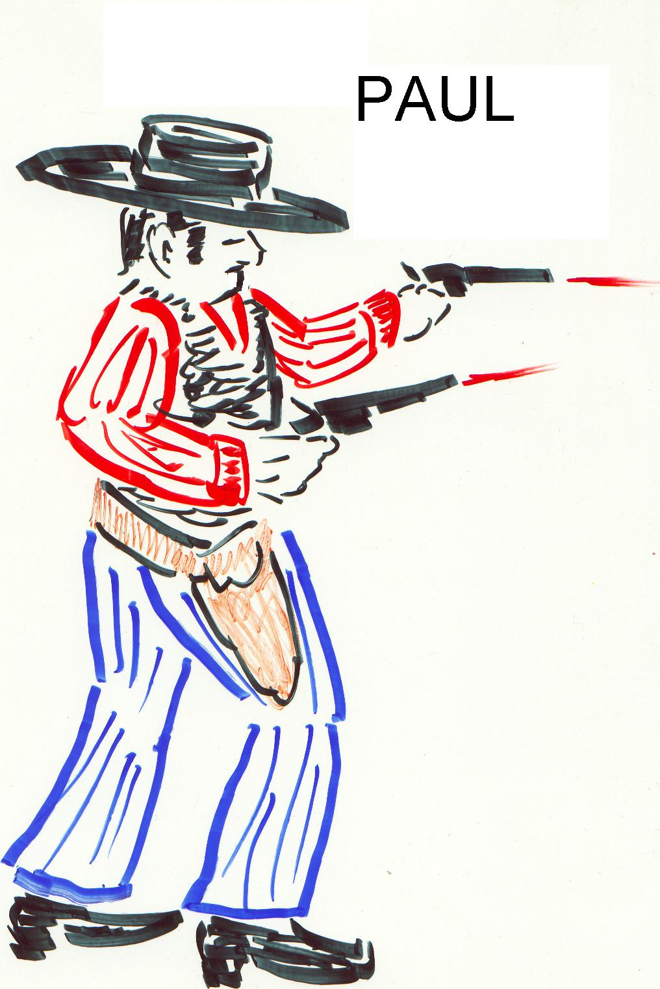
Is This the Picture?

Slide 24
Suggested Resolution
These are verbal, but not real, contradictions.
They can be resolved by looking at the contexts.
The "confusion in terms" suggests a pre-Jerusalem Council date for James, and possibly for Galatians.

Slide 25
Suggested Resolution
James recognizes one cannot keep the Law perfectly.
2:10 – "whoever keeps the whole Law, yet stumbles in one point is guilty of all”
3:1-2 – "we all stumble in many ways"
James is emphasizing that real Christians will have works in their lives.

Slide 26
Suggested Resolution
Paul's teaching is the same as James'
Salvation is by dependence on Christ
We cannot depend on our works
Gal 5:3 – "whoever receives circumcision is obligated to keep the whole law"
6:13 – "those who are circumcised do not even keep the law themselves"
5:6 – "neither circumcision nor uncircumcision means anything, but faith working thru love."

Slide 27
Suggested Resolution
Paul and James are responding to different errors
James to antinomians:
Faith only; live as you please
Paul to legalists:
Works are required in order to save

Slide 28
Suggested Resolution

Slide 29
Emphasis of James
More practical than doctrinal
This is similar to many OT books
Proverbs
Prophets
Also similar to Jesus' teaching in the Gospels

Slide 30
James & Sermon on Mount
Jas 1:22 & Mt 7:24-27
Doers, not just hearers
Jas 2:5 & Mt 5:3
Poor of this world
Jas 2:10 & Mt 5:19
One point of the Law

Slide 31
James & Sermon on Mount
Jas 3:12 & Mt 7:16
Fruits
Jas 4:11, 5:9 & Mt 7:1ff
Judging
Jas 5:12 & Mt 5:34-37
Oaths, "yes, yes"

Slide 32
Other Parallels
Jas 1:27, 2:5,15 resemble the judgment scene in Matthew 25.
Check the cross-references in James 1:2, 20; 2:8; 4:4
Was Matthew already written when James wrote?
Possible, but surely James knew the apostolic preaching

Slide 33
Outline of James

Slide 34
Davids' Thematic Outline
Introduction (1:1-27)
Greeting (1:1)
Themes Presented (1:2-27)
Test of Faith
Speech and Spirit
Piety and Poverty
Themes Developed (2:1-5:6)

Slide 35
Thematic Outline
Themes Developed (2:1-5:6)
Piety & Poverty (2:1-26)
Speech & Spirit (3:1-4:12)
Test & Result (4:13-5:6)
Conclusion (5:7-20)
With themes restated

Slide 36
Huddleston's Acrostic Outline
Working patience thru trials
Obedience accompanies true faith
Restraining the unbridled tongue
Keeping calm in conflicts
Sick and suffering saints

Slide 37
The Argument of James
A condensed, explanatory paraphrase

Slide 38
The End
Faith without works is dead!

